Slide 1
A Heart That Pleases God
To Run the Good Race
Amy Tan
25/02/2018

Slide 2
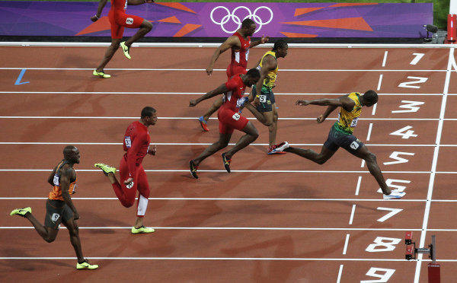

Slide 3


Slide 4
1. Obedience
Definition according to Oxford dictionary:
- Compliance with an order, request, or law or submission to another’s authority

Slide 5
1. Obedience
Obedience to God | Disobedience to God
Life | Death
Leads to: God’s promised blessing of life | Leads to: Curse, judgement and death

Slide 6
1. Obedience
Biblical example:
Abraham
    He obeyed God’s command to go to a new land
        Gen 12:1-4
    He obeyed God’s command to offer his son as a sacrifice
        Gen 22:1-19

Slide 7

2. Attitude
  How do we respond to God’s dealing of our heart condition?

Slide 8
2. Attitude
Biblical example:
Saul/Paul
  Acts 9:1-9
    Saul’s initial attitude of the Gospel was to persecute the believers
    When God spoke to him on the road of Damascus, there was a change of attitude
    From persecutor to servant

Slide 9
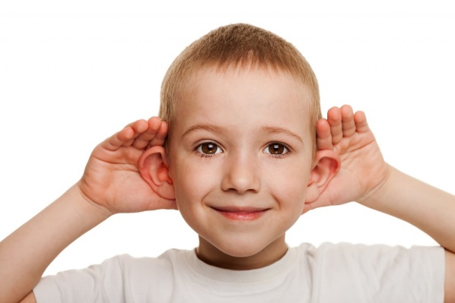
3. Hear God’s Voice
    Listen to God’s voice with both ears
        Exo 15: 26
          Emphasis of what we listen to
    Listen diligently to God’s voice
        Deut 28:1-2, 15
          Listen and obey – blessings
          Listen and do not obey - curses

Slide 10

3. Hear God’s Voice
Guard our heart
    Prov 4:23
- Keep our heart pure
    Matt 5:8

Slide 11
Conclusion
Constantly work with the Holy Spirit to keep your heart right
If you want to be a victorious Christian, guard your heart – even when you don’t feel like it

